Slide 1
Complementing the Health and Retirement Study: RAND HRS Data Files
RAND Center for the Study of Aging
June 2018

Slide 2
Acknowledgements
Funding for the HRS data collection and RAND HRS data development provided by the Social Security Administration (SSA) and the National Institute on Aging (NIA)
Data developed by the RAND Center for the Study of Aging

Slide 3
New Names for RAND HRS Files
Beginning with files released in fall 2017, RAND HRS data products follow new naming conventions
Latest year of
data available
RAND HRS Longitudinal File 2014 (V2)
File base name
RAND release number
Old base name | New base name
RAND HRS Data File | RAND HRS Longitudinal File
RAND Income & Wealth Imputation File | RAND HRS Detailed Imputations File
RAND Family Data Files | RAND HRS Family Data Files
RAND CAMS Spending Data File | RAND HRS CAMS Data File
RAND Enhanced Fat Files | RAND HRS Fat Files

Slide 4
Why RAND HRS Data Files?
Purpose: to facilitate empirical research on aging by creating easy-to-use files containing select HRS data
Save time and effort
Quality and consistency
Used by many researchers with a wide variety of interests
Feedback from researchers improves the quality of variables
Capitalize on the experience of HRS PIs and the RAND programming team (“No need to reinvent the wheel”)
External “sanity check” for your own variable derivations
Contribute to a community of data users
Examine quality of variables in your area of expertise
Provide valuable feedback to the aging research community

Slide 5
Facilitate Longitudinal Analyses
RAND data files contain observations for every individual who has ever completed a survey* from the HRS
Variables are constructed to be longitudinally comparable across survey years
Consistent naming conventions
Extensive documentation, especially useful for tracking cross-wave changes in the survey instrument
* Later slides provide details on which survey respondents must complete in order to be included in a particular RAND data file.

Slide 6
Variable Names
All derived variables in RAND HRS data files follow a standardized naming convention
RAND HRS Wave
R6SHLT
Who variable
reports on:
Respondent
Spouse
Household
Variable stem:
Self-reported health

Slide 7
Derived Variable Documentation
Each group of variables has standardized documentation in the Codebook:
Variable list: for each wave, contains name, label and variable type (continuous or categorical)
Descriptive statistics: N, mean, std deviation, minimum, maximum
Categorical variable codes: all variable values and frequencies by survey wave
How constructed: defines what information the variable captures and describes missing values
Cross wave differences in the original HRS data: describes any changes in the survey that may impact longitudinal analysis
HRS variables used: name and label of all raw HRS variables used to construct the variable

Slide 8
RAND HRS Data Products
HRS Core Public Release Data Modules
CAMS
RAND HRS Fat Files
RAND HRS CAMS
Data File
2015 (V2)
RAND HRS Longitudinal File
2014 (V2)
RAND HRS Detailed Imputations File
2014 (V2)
RAND HRS Family Data Files
2014 (V1)
RAND HRS Exit/Post-Exit Interview and Finder Files
2014 (V1)
RAND HRS Tax Calculations 2014 (V2)

Slide 9
RAND HRS Longitudinal File 2014 (V2)
Easy-to-use entry point to HRS data
Contains rich subset of HRS information for every individual who has completed at least one wave of the core HRS, along with analogous spouse variables
Data available from 1992-2014
All variables have standardized naming conventions and are well documented
Easily merges with all other RAND HRS data files, as well as raw HRS data modules

Slide 10
Who (and What Survey) Is In Each Wave?
RAND HRS Wave | HRS Core Survey Year | Cohorts Included
1 | 1992 | HRS, AHEAD
2 | 1993, 1994
3 | 1995, 1996
4 | 1998 | HRS, AHEAD, CODA, WB
5 | 2000
6 | 2002
7 | 2004 | HRS, AHEAD, CODA, WB, EBB
8 | 2006
9 | 2008
10 | 2010 | HRS, AHEAD, CODA, WB, EBB, MBB
11 | 2012
12 | 2014

Slide 11
What’s In RAND HRS Longitudinal File?
Derived variables drawn from Tracker and respondent and household level modules of Core HRS data
Sections include demographics, health, income, financial and housing wealth, family structure, employment history, retirement plans
Key variables (w=wave):
HHIDPN: unique identifier that can be used to merge the RAND HRS Longitudinal File with other HRS and RAND datasets
SwHHIDPN: HHIDPN for a respondent’s spouse in a given wave
INWw: flags that identify whether a respondent completed a particular survey wave

Slide 12
Example: Tenure at Current Job 2012
If working, the respondent is asked about job start date at first interview
If respondent is still working at same job in subsequent interview, job start date question is not repeated
Raw HRS Employment Data
HRS 2012
PN | NJ020 | NJ248/9
 | Working? | Start Date
JACK | Yes | .
JILL | Yes | .
HRS 2010
PN | MJ020 | MJ248/9
 | Working? | Start Date
JACK | Yes | .
JILL | Yes | .
HRS 2008
PN | LJ020 | LJ248/9
 | Working? | Start Date
JACK | Yes | 4/1998
JILL | Yes | 3/2002
RAND HRS Longitudinal File
The amount of time working at the job is carried forward, as appropriate, so to find job tenure in 2012, you need only look at R11JCTEN
 |  | 2006 | 2008 | 2010 | 2012
HHIDPN | … / | R8JCTEN | R9JCTEN | R10JCTEN | R11JCTEN
JACK |  | . | 10 | 12 | 14
JILL |  | . | 6 | 8 | 10

Slide 13
RAND HRS Data Products
HRS Core Public Release Data Modules
CAMS
RAND HRS Fat Files
RAND HRS CAMS
Data File
2015 (V2)
RAND HRS Longitudinal File
2014 (V2)
RAND HRS Detailed Imputations File
2014 (V2)
RAND HRS Family Data Files
2014 (V1)
RAND HRS Exit/Post-Exit Interview and Finder Files
2014 (V1)
RAND HRS Tax Calculations 2014 (V2)

Slide 14
RAND HRS Fat Files
One file for each survey year (1992, 1993, 1994, etc.)
Contain most raw HRS variables from household and respondent level core modules
Merged to the respondent level
Each Fat file can be easily merged with other Fat files, RAND HRS data files, and raw HRS modules
Merge to RAND HRS data files with HHIDPN
Merge to raw HRS modules with a combination of HHID and PN

Slide 15
What’s in RAND HRS Fat Files? (one for each survey year)
HOUSEHOLD LEVEL
MODULES:
Preload
Coverscreen (CsR)
Family Structure (FamR)
Housing (FinR)
Assets and Income (FinR)
Asset Change (FinR)
RESPONDENT LEVEL
MODULES:
Preload
Coverscreen
Demographics
Physical Health
Cognition
Parents and Siblings
Functional Limitations
Physical Measures
Employment (1-6 sections)
Health Services and Insurance
Expectations
Widowhood and Divorce
Wills and Life Insurance
Experimental Modules
Event History and Social Security
Interviewer Observations
RESPONDENT LEVEL
FAT FILE

Slide 16
Translating Household Level Variables
Some raw HRS modules are only asked of one member of a household
Information from these modules are attached to both the respondent and spouse record, with additional variables to clarify to whom information applies
HOUSEHOLD LEVEL
MODULES:
Preload
Coverscreen (CsR)
Family Structure (FamR)
Housing (FinR)
Assets and Income (FinR)
Asset Change (FinR)

Slide 17
Example: Wage/Salary, HRS 2006
KQ020 is the amount that the Financial Respondent (FinR) made from wages and salary in the last calendar year
KQ045 is the same information for the FinR’s spouse
Raw data
Demographics (Respondent level)
Assets and Income
(Household level)
PN | KFINR | KPN_SP
 | Is FINR? | Spouse ID
JACK | Yes | JILL
JILL | No | JACK
PN | KQ020 | KQ045
 | FINR Amt | FINR Sp Amt
JACK | 300 | 1500
RAND HRS Fat File
PN | KFINR | KQ020 | KQ045 | KQR020 | KQP020
 | Is FINR | FINR Amt | FiNR Sp Amt | R Amount | S Amount
JACK | Yes | 300 | 1500 | 300 | 1500
JILL | No | 300 | 1500 | 1500 | 300
1. Merge data
2. Add clarifying variables

Slide 18
RAND HRS Data Products
HRS Core Public Release Data Modules
CAMS
RAND HRS Fat Files
RAND HRS CAMS
Data File
2015 (V2)
RAND HRS Longitudinal File
2014 (V2)
RAND HRS Detailed Imputations File
2014 (V2)
RAND HRS Family Data Files
2014 (V1)
RAND HRS Exit/Post-Exit Interview and Finder Files
2014 (V1)
RAND HRS Tax Calculations 2014 (V2)

Slide 19
RAND Detailed Imputations File 2014 (V2)
Longitudinal file (1992-2014) with one record for every individual who has completed at least one HRS interview
Derived variable file to supplement the RAND HRS Longitudinal File
Contains additional variables to provide greater granularity about Income, Wealth and Out-of-Pocket Medical Expenditures
Two sets of Wealth imputations
Cross-section: Imputation models that create estimates using only data from the current wave
Cross-wave: Imputation models that that create estimates using data from the current and adjacent waves

Slide 20
Imputation Methods
The imputation process is progressive, that is - we impute ownership, then brackets, and then amounts
For further details on the imputation methods, see:
RAND HRS Longitudinal File Codebook
RAND Detailed Imputations File Codebook
Michael D. Hurd, Erik Meijer, Michael Moldoff, and Susann Rohwedder. Improved Wealth Measures in the Health and Retirement Study: Asset Reconciliation and Cross-Wave Imputation. Santa Monica, CA: RAND Corporation, 2016. http://www.rand.org/pubs/working_papers/WR1150.html

Slide 21
Example: Individual Earnings (RwIEARN)
RwIEARN: Individual Earnings, along with RwIFEARN, appears in both RAND HRS Longitudinal File and the RAND Detailed Imputations File
RAND Detailed Imputations also has component variables:
RwIWAGE: Wage/salary income
RwIBON: Bonuses/overtime pay/commissions/tips
RwI2ND: 2nd job/military reserve earnings
RwITRAD: Professional practice/trade income
Additional details about each component:
Ownership flags: indicate whether respondent receives any income of that type (RwIOWAGE, RwIOBON, RwIO2ND, etc.)
Imputation status variables: indicate whether the amount has been imputed (RwIFWAGE, RwIFBON, RwIF2ND, etc.)

Slide 22
Example: Value of all mortgages/land contracts (primary residence) (HwAMORT)
HwAMORT: Total value of all mortgages (cross-wave), along with HwAFMORT, appears in both RAND HRS Longitudinal File and the RAND Detailed Imputations File
Additional information found only in RAND Detailed Imputations File:
Component values: 1st (HwAMRT1) and 2nd (HwAMRT2) mortgages
Ownership flags: indicate if household has any outstanding mortgage debt (HwAOMORT, HwAOMRT1, HwAOMRT2)
Imputation status variables: indicate if amount has been imputed (HwAFMORT, HwAFMRT1, HwAFMRT2)
Cross-section imputation variables: include amounts (HwWMORT, HwWMRT1, HwWMRT2), ownership flags (HwWOMORT, HwWOMRT1, HwWOMRT2) and imputation status variables (HwWFMORT, HwWFMRT1, HwWFMRT2)

Slide 23
RAND HRS Data Products
HRS Core Public Release Data Modules
CAMS
RAND HRS Fat Files
RAND HRS CAMS
Data File
2015 (V2)
RAND HRS Longitudinal File
2014 (V2)
RAND HRS Detailed Imputations File
2014 (V2)
RAND HRS Family Data Files
2014 (V1)
RAND HRS Exit/Post-Exit Interview and Finder Files
2014 (V1)
RAND HRS Tax Calculations 2014 (V2)

Slide 24
RAND HRS Family Data Files 2014 (V1)
Two files supplement the RAND HRS Longitudinal File
Respondent-kid file: each record is one respondent/kid pair for respondents who completed at least one wave of the core HRS
Respondent file: each record is one respondent who completed at least one wave of the core HRS
Longitudinal files (1992-2014)
Contain additional variables to provide greater granularity about the characteristics of respondent’s families, including kids, kids-in-law, parents and siblings

Slide 25
RAND HRS Longitudinal vs. RAND HRS Family
RAND HRS Longitudinal File has only limited variables about respondents’ families:
HwHHRES: number of people living in household
HwCHILD: number of living children
RwLIVBRO, RwLIVSIS: number of living brothers/sisters
RAEVBRN: Number of children ever born
RAND HRS Family Data Files have comprehensive information in the following areas:
Kid & parent demographics: age, education, marital status, etc.
Kid assistance to respondent: ADLs, IADLs, finances
Respondent assistance to kid: childcare, finances
Respondent assistance to parent: personal care, finances
Sibling assistance to parents

Slide 26
Example: Financial Assistance to Kids
Two levels of analysis available:
KwTCAMT: amount of financial assistance of over $500 provided to an individual kid in past 2 years (R-K file)
HwTCAMT: total amount of financial assistance over $500 provided to all kids in past 2 years (R file)
HRS variables used in calculations are in the Family Structure (Children) and Transfers module (E_TC), which is not included in RAND HRS Fat files

Slide 27
RAND HRS Data Products
HRS Core Public Release Data Modules
CAMS
RAND HRS Fat Files
RAND HRS CAMS
Data File
2015 (V2)
RAND HRS Longitudinal File
2014 (V2)
RAND HRS Detailed Imputations File
2014 (V2)
RAND HRS Family Data Files
2014 (V1)
RAND HRS Exit/Post-Exit Interview and Finder Files
2014 (V1)
RAND HRS Tax Calculations 2014 (V2)

Slide 28
RAND HRS CAMS Data File 2015 (V2)
User friendly version of Part B of the CAMS survey
Contains annualized, cleaned and aggregated spending and consumption variables
Data from all waves of CAMS: every odd year beginning in 2001
Respondent-level file containing data for all respondents who completed Part B of the survey for at least one wave

Slide 29
RAND HRS CAMS Data File
All measures reported at the household level
Seven spending measures:
Total household spending
Total durables spending
Total non-durables spending
Total transportation spending
Total housing spending
Car purchases and payments
Mortgage payments and interest
Four consumption measures:
Total household consumption
Total durables consumption
Total transportation consumption
Total housing consumption

Slide 30
Example: Total transportation consumption (HwCTRANSC)
Components:
Interest on the value of all automobiles
Value derived from HRS from years surrounding CAMS survey
Interest rate is 3-year moving average on 48 month auto loans published by Federal reserve
10% depreciation
Auto insurance costs
Spending on gasoline
More details on the methods used in RAND HRS CAMS are available in the RAND HRS CAMS codebook

Slide 31
RAND HRS Data Products
HRS Core Public Release Data Modules
CAMS
RAND HRS Fat Files
RAND HRS CAMS
Data File
2015 (V2)
RAND HRS Longitudinal File
2014 (V2)
RAND HRS Detailed Imputations File
2014 (V2)
RAND HRS Family Data Files
2014 (V1)
RAND HRS Exit/Post-Exit Interview and Finder Files
2014 (V1)
RAND HRS Tax Calculations 2014 (V2)

Slide 32
RAND HRS Exit/Post-Exit Interview Files 2014 (V1)
Include all respondents from the Exit and Post-Exit Interviews
One file for each year, beginning with HRS 1994
Each file includes all of the respondent-level modules, but not those collected at other levels (e.g., Section G: Functional Limitations and Helpers)
A Finder file permits users to combine information from the Exit/Post-Exit Interviews, and merge them with Core Interviews

Slide 33
RAND HRS Exit/Post-Exit Interview Files
How are the Exit/Post-Exit Interview data combined?
Similar variable naming conventions (e.g., 2014 net value of estate, Exit = YT173, Post-Exit = YPT173)
Rename Post-Exit variable names to append Post-Exit Interview data on the Exit Interview data
POST_EXIT flag is included to distinguish Exit (= 0) and Post-Exit (= 1) Interviews
Respondents never have both an Exit and a Post-Exit Interview in the same year
Key Identifiers
Exit/Post-Exit Interview Files: HHIDPN, HHID, PN, SUBHH
Exit/Post-Exit Finder File: HHIDPN

Slide 34
Example: Disposition of Home
HRS Exit 2004: What happened to that home (TT102)?
HRS Post-Exit 2004: What happened to that home (TPT102)?
Raw data
Exit
Post-Exit
HHIPDN | TT102
Jack | 8. DK
HHIPDN | TPT102
Sam | 2. Sold
RAND HRS Exit/Post-Exit 2004 Interview and Finder File
HHIDPN | TT102 | POST_EXIT
Jack | 8. DK | 0
Sam | 2. Sold | 1
HHIDPN | EXIT1 | POSTEXIT1 | POSTEXIT2 | POSTEXIT3
Jack | 2004 | 2006 | 2008
Sam | 2000 | 2004
1. Combine Exit and Post-Exit data
2. Finder File variables

Slide 35
RAND HRS Data Products
HRS Core Public Release Data Modules
CAMS
RAND HRS Fat Files
RAND HRS CAMS
Data File
2015 (V2)
RAND HRS Longitudinal File
2014 (V2)
RAND HRS Detailed Imputations File
2014 (V2)
RAND HRS Family Data Files
2014 (V1)
RAND HRS Exit/Post-Exit Interview and Finder Files
2014 (V1)
RAND HRS Tax Calculations 2014 (V2)

Slide 36
RAND HRS Tax Calculations 2014 (V2)
Use the NBER Internet TAXSIM** calculator to compute federal, state, and FICA taxes for respondents to the HRS 2000 – 2014 surveys
Two files for each year, beginning with HRS 2000:
TAXSIM input and output variables
“Raw” variables used in the derivations
Marginal tax rates (i.e., how much would the household pay in taxes if its income increased by a given amount) are included in the form of “finite difference” calculations (i.e., $1k, $5k, $10k, and $50k)
** Feenberg, D.R., and Coutts, E. (1993), “An Introduction to the TAXSIM Model”, Journal of Policy Analysis and Management, 12(1), 189-194.

Slide 37
RAND HRS Tax Calculations
HRS respondents are generally asked to report their income before taxes and any other deductions
For a number of research purposes, after-tax income would be the most appropriate:
Saving behavior
Economic well-being

Slide 38
RAND HRS Tax Calculations
Input variables
22 fields, including tax year, marital status, wage and salary income, deductions
Constructed using information from our other data products:
RAND HRS Longitudinal File
RAND Detailed Imputations File
RAND HRS Fat Files
Output Variables
Federal, state, and FICA (Social Security and Medicare) taxes
Marginal tax rates in the form of finite difference calculations (i.e., $1k, $5k, $10k, and $50k)
Calculations performed 51 times for each respondent, once for each state and DC
Key Identifiers: HHIDPN, HHID, and PN

Slide 39
Getting Started Using RAND Data

Slide 40
Identifying Respondents
Data Set | Variables | Example
HRS Public Release | HHID [char 6] PN [char 3] | "054321" "010"
RAND HRS Longitudinal File RAND HRS Family Data RAND Detailed Imputations | HHID [char 6] PN [char 3] HHIDPN [num] / RAHHIDPN [char 9] | "054321" "010" 54321010 / "054321010"
RAND HRS Fat Files | HHID [char 6] / HHIDN [num] PN [char 3] / PNN [num] HHIDPN [num] / RAHHIDPN [char 9] | "054321" / 54321 "010" / 10 54321010 / "054321010"
RAND HRS CAMS Data File | HHIDPN [num] | 54321010
RAND HRS Tax Calculations | HHID [char 6] PN [char 3] HHIDPN [num] | "054321" "010" 54321010
RAND HRS Exit/Post-Exit Files | HHID [char 6] / HHIDN [num] PN [char 3] / PNN [num] HHIDPN [num] / RAHHIDPN [char 9] | "054321" / 54321 "010" / 10 54321010 / "054321010"

Slide 41
Identifying Households
Data Set | Variables | Example
HRS Public Release | HHID [char 6] xSUBHH [char 1] | "054321" "0"
RAND HRS Longitudinal File RAND HRS Family Data RAND HRS Detailed Imputations | HwHHID [num] | 543210
RAND HRS Fat Files | HHID [char 6] / HHIDN [num] xSUBHH [char 1] / xSUBHHN [num] xHHID [char 7] xHHIDN = HwHHID [num] | "054321" / 54321 "0" / 0 "0543210" 543210
RAND HRS CAMS Data File | No household ID variables - use respondent variables
RAND HRS Tax Calculations | HHID [char 6] | "054321"
RAND HRS Exit/Post-Exit Files | HHID [char 6] / HHIDN [num] xSUBHH [char 1] / xSUBHHN [num]* xHHID [char 7] / xHHIDN [num]* | "054321" / 54321 "0" / 0 "0543210" / 543210
* For current (e.g., 2014) and previous (e.g., 2012) waves. See RAND HRS Exit/Post-Exit documentation, and HRS Data Description and Usage documentation for more details.

Slide 42
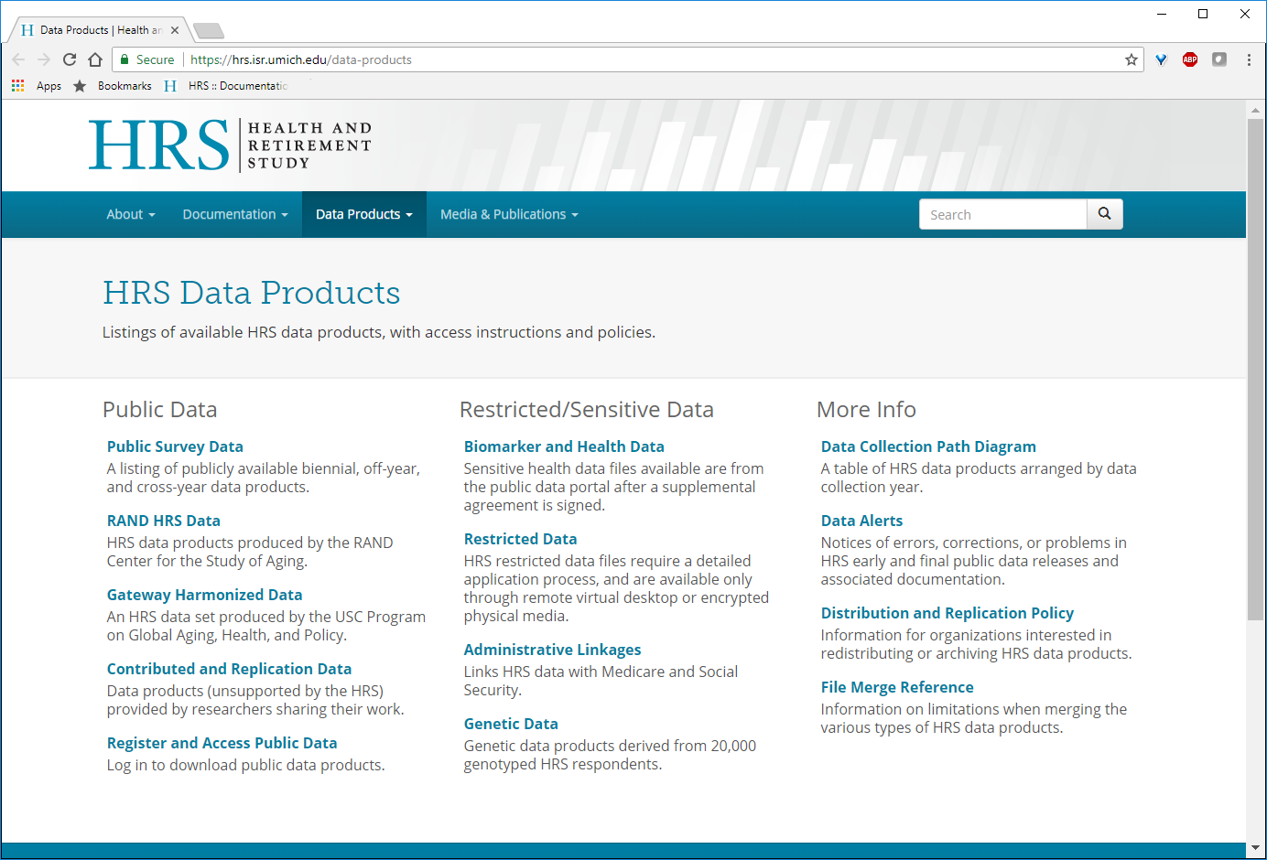
Downloading RAND Data
Go to https://hrs.isr.umich.edu/data-products and click Register and Access Public Data
Click Registered Users (registration is required), and enter Userid and Password

Slide 43
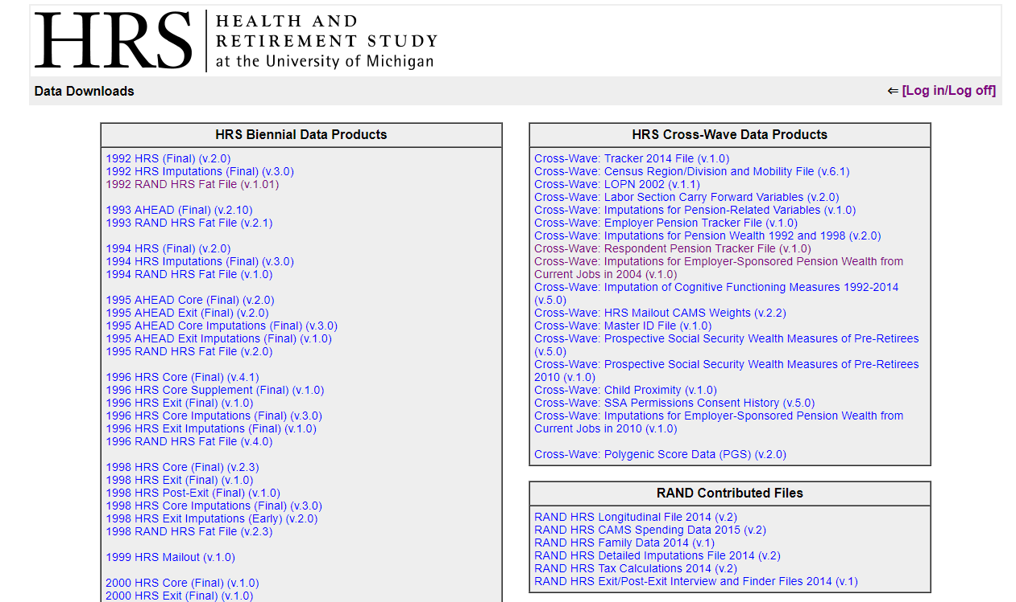
Downloading RAND Data
After logging in, proceed to the Data Downloads page
The RAND versions of the HRS data can be found in the RAND Contributed Files and HRS Biennial Data Products sections
RAND HRS Fat files

Slide 44
What’s Included in the Download
Select desired format of file:
SAS
STATA
SPSS
Each .zip file contains the following:
Codebook or Data README
Formats (SAS)
Data file (SAS, STATA, SPSS)
Programs to create derived variables (SAS)*
* The RAND HRS Longitudinal File, and the RAND HRS Detailed Imputations File

Slide 45
Set up
Many of the variables derived by RAND have been assigned SAS formats or value labels
To view data, you will first need to create a formats catalog using the following code:
libname library “[fill in file path here]”;
proc format library=library cntlin=library.sasfmts;
run;
This will create a file called [file path]\formats.sas7bdat

Slide 46
Sample Merge
RAND HRS Longitudinal File
(randhrs1992_2014v2)
RAND HRS Detailed Imputations File (randhrsimp1992_2014v2)
RAND HRS 2014 Fat File
(h14f2a)
data hrsout.newhrs;
merge hrsin. randhrs1992_2014v2 (keep=HHIDPN R12JCTEN ..)
hrsin.h14f2a (keep=HHIDPN OQR020 ..)
hrsin.randhrsimp1992_2014v2 (keep=HHIDPN ..)
by HHIDPN;
[ code to derive new variables]

Slide 47
Overlap cases
Two types of overlap case users should be aware of:
HRS-AHEAD overlaps
Interviewed in 1992 as HRS households, with HRS IDs
Given to AHEAD 1993, and continue to be followed as AHEAD households, with AHEAD IDs
AHEAD-AHEAD overlaps
Married into a different AHEAD household
Linked longitudinally in RAND HRS data products
More information available in the RAND HRS Longitudinal File codebook

Slide 48
Questions and Comments
RAND Center for the Study of Aging
www.rand.org/labor/aging
RAND HRS Help
Email: randhrshelp@rand.org

